Slide 1

DATA 1204 Statistical and Predictive Modeling for Analytics Assignment 4-Chi Square Analysis Professor: Ritwick Dutta Srilasya Garigipaty Student #100822953

Slide 2

Chi-Squared Analysis
Chi-Square test is a statistical method to determine if two categorical variables have a significant correlation between them.
Chi-square test is only meant to test the probability of independence of a distribution of data.
The chi-square test can be used to determine whether observed frequencies are significantly different from expected frequencies- it is known as a goodness of fit test.
Chi-Square Test used to test the statistically significant relationship in a sample. (for categorical variables)

Slide 3
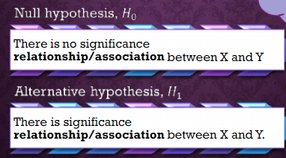
Conditions Chi-Square Test needs to adhere to:
Scale of Measurement: nominal or ordinal and the data should be in frequency.
Samples are randomly selected.
The observations are independent.
The Chi-Square cannot be computed if the expected value in any category is less than 5.
Chi-Square test can be used to determine whether two qualitative/categorical variables are independent or not. The conclusion about whether the variables are “correlated", "independent” or “not associated” is concluded.
Test of Significance for Relationship/Association

Slide 4
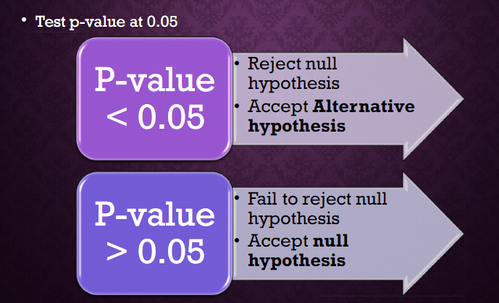
How is independence and correlation tested in Chi-Square test
P-value- measure that quantifies the strength of the evidence made about a population parameter. It is the strength of the evidence against null hypothesis and in favor of the alternative hypothesis. A p-value is compared relative to the value of significance level. If p-value is greater than or less than significance level the null hypothesis is rejected.

Slide 5
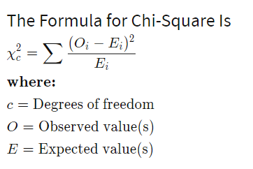
Degrees of Freedom
The degrees of freedom (often abbreviated as df or d) tell you how many numbers in your grid are independent. The degrees of freedom for a Chi-square grid are equal to the number of rows minus one times the number of columns minus one: that is, (R-1)*(C-1). Degrees of freedom are important in a Chi-square test because they factor into your calculations of the probability of independence
Chi-Square Statistic
A chi-square (χ²) statistic is a measure of the difference between the observed and expected frequencies of the outcomes of a set of events or variables.
χ² depends on the size of the difference between actual and observed values, the degrees of freedom, and the samples size.
χ² can be used to test whether two variables are related or independent from one another or to test the goodness-of-fit between an observed distribution and a theoretical distribution of frequencies.
When the observed values and expected values are close together , the chi-square test value will be small.

Slide 6
Steps to Perform a Chi-Square Test
Step 1: State the hypotheses and define the claim
Null Ho: Number of cylinders(Cylinders) is not correlated with type of car sold (Type)
Alternative Ha: Number of cylinders(Cylinders) is correlated with type of car sold (Type)
Step 2: State the confidence level and calculate degrees of freedom
df=25, α=0.05
Step 3:Run the Chi-Square Test
Step 4: Determine the Chi-Square Statistic and P-value
Step 5: Compare the P-value to the confidence interval, and decide based upon criteria to reject or accept the null hypothesis.
Step 6:Summarize the results.

Slide 7
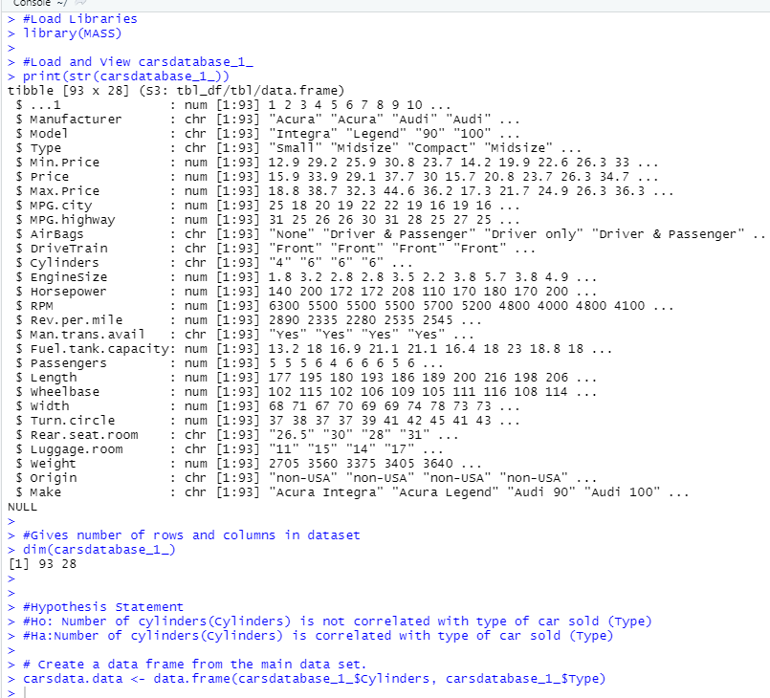
R-Implementation
Output
#Load Libraries
library(MASS)
#Load and View carsdatabase_1_
print(str(carsdatabase_1_))
#Gives number of rows and columns in dataset
dim(carsdatabase_1_)
#Hypothesis Statement
#Ho: Number of cylinders(Cylinders) is not correlated with type of car sold (Type)
#Ha:Number of cylinders(Cylinders) is correlated with type of car sold (Type)
# Create a data frame from the main data set.
carsdata.data <- data.frame(carsdatabase_1_$Cylinders, carsdatabase_1_$Type)

Slide 8
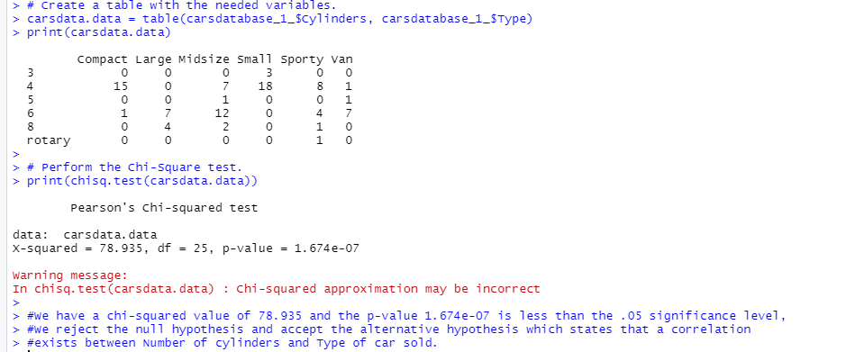
R-Implementation
Output
# Create a table with the needed variables.
carsdata.data = table(carsdatabase_1_$Cylinders, carsdatabase_1_$Type)
print(carsdata.data)
# Perform the Chi-Square test.
print(chisq.test(carsdata.data))
#We have a chi-squared value of 78.935 and the p-value 1.674e-07 is less than the .05 significance level,
#We reject the null hypothesis and accept the alternative hypothesis which states that a correlation exists between Number of cylinders and Type of car sold.

Slide 9
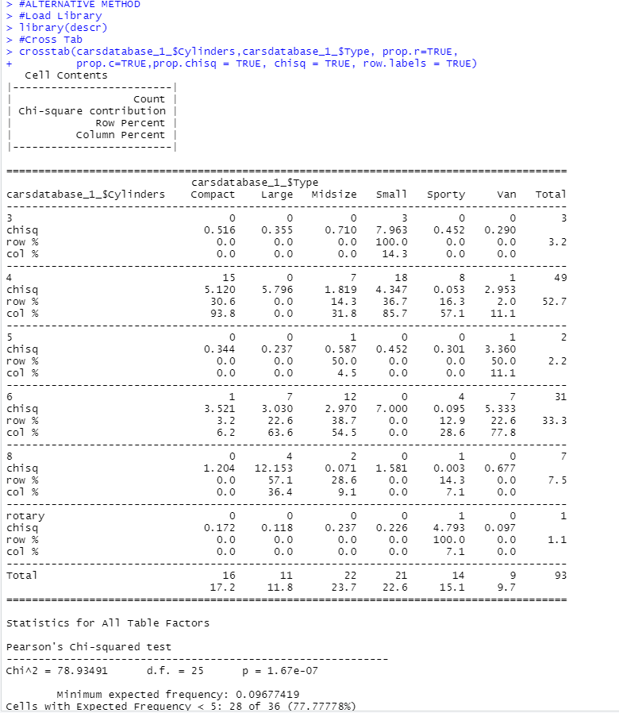
R-Implementation
Output
#ALTERNATIVE METHOD
#Load Library
library(descr)
#Cross Tab
crosstab(carsdatabase_1_$Cylinders,carsdatabase_1_$Type, prop.r=TRUE,
prop.c=TRUE,prop.chisq = TRUE, chisq = TRUE, row.labels = TRUE)

Slide 10
Insights From Finding in Chi Squared Test Implementation
We have a chi-squared value of 78.935 and the p-value 1.674e-07 which is less than the .05 significance level,
We reject the null hypothesis which states that a correlation does not exists between Number of cylinders and Type of car sold and accept the alternative hypothesis which states that a correlation exists between Number of cylinders and Type of car sold.
Since the chi square statistic is large, we can assume that there is a strong relationship between the Number of Cylinders and Type of Car Sold. From table below, it is seen that the most cars were of Small Type with 4 Cylinders. The highest chi-square contribution was from Small Type with 3 Cylinders.
Chi-Square Values for each Type of Car Sold by Number of Cylinders
Count Values for each Type of Car Sold by Number of Cylinders
Number of Cylinder | Compact | Large | Midsize | Small | Sporty | Van
3 | 0.516 | 0.355 | 0.710 | 7.963 | 0 | 0
4 | 5.120 | 5.796 | 1.819 | 4.347 | 0.053 | 2.953
5 | 0.344 | 0.237 | 0.587 | 0.452 | 0.301 | 3.360
6 | 3.521 | 3.030 | 2.970 | 7.000 | 0.095 | 5.333
8 | 1.204 | 12.153 | 0.071 | 1.581 | 0.03 | 0.677
rotary | 0.172 | 0.118 | 0.237 | 0.226 | 4.793 | 0.097
Number of Cylinder | Compact | Large | Midsize | Small | Sporty | Van
3 | 0 | 0 | 0 | 3 | 0 | 0
4 | 15 | 0 | 7 | 18 | 8 | 1
5 | 0 | 0 | 1 | 0 | 0 | 1
6 | 1 | 7 | 12 | 0 | 4 | 7
8 | 0 | 4 | 2 | 0 | 1 | 0
rotary | 0 | 0 | 0 | 0 | 1 | 0

Slide 11
What Other Two Combinations would you test?
R- Combination Code Attempts
#Create Table
tbl = table(carsdatabase_1_$Cylinders, carsdatabase_1_$Type)
# the contingency table
tbl
#New Table
ctbl = cbind(tbl[,"Compact"], tbl[,"Large"] + tbl[,"Midsize"]+ tbl[,"Small"]+ tbl[,"Sporty"]+ tbl[,"Van"])
ctbl
#Chi-squared New Table
chisq.test(ctbl)
#New Table 1
ctbl1 = cbind(tbl[,"Compact"]+ tbl[,"Midsize"]+ tbl[,"Small"], tbl[,"Large"] + tbl[,"Sporty"]+ tbl[,"Van"])
ctbl1
#Chi-squared New Table1
chisq.test(ctbl1)
#New Table 2
ctbl2 = cbind( tbl[,"Midsize"],tbl[,"Sporty"]+tbl[,"Compact"]+ tbl[,"Large"] + tbl[,"Small"]+ tbl[,"Van"])
ctbl2
#Chi-squared New Table1
chisq.test(ctbl2)
Enhanced Solution
The warning message found in the solution that has been done in R implementation is due to the small cell values in the contingency table. To avoid such warning, we combine the various columns of tbl table created , and save it in a new table named ctbl. Then we apply the chisq.test function against ctbl instead.
Various Combinations should be attempted until warning message is gone by combining columns of contingency table. Attempted are three combinations, however further exploration needs to be done to find the best combination.

Slide 12
References:
DATA 1204 Week 10 Class notes
https://www.scribd.com/presentation/104559845/Stat-130-Chi-Square-Goodnes-Of-Fit-Test
https://www.scribd.com/presentation/366469873/CHI-SQUARE-TEST-ppt

